Slide 1
The Matrix: Cybersecurity Standards Cross-Mapping
Alex Assante

Slide 2
Background
What is a Cybersecurity Standard?
Purpose:
Prevent Cyber Incidences
Detect and Identify Cyber Threats
Protect Against Cyber Threats
Respond To Cyber Threats
Recover From Cyber Incidences
Cybersecurity Standards are an amalgamation of best practices compiled by Cybersecurity experts to protect organizations from cyber threats.

Slide 3
My Project
Research Project analyzing the relationships between Cybersecurity Standards
Work was split into two stages:
Researching the standards (NERC CIP, CIS Top 18, NIST Framework)
Building the cross-mapping tool
Work began in October researching the standards
Didn’t get to start mapping until February/March.
Approximately 300-400 hours of Total Work

Slide 4
My Project
Due to this project being a Research Project, it’s not too glamorous…. Most of the work was done behind the scenes in learning all the standards and analyzing them.
Cross-mapping tool built in Excel
Ease of information sharing
Organization
Analysis Capabilities
Industry Standard
Tool used for cross-mapping illustration
Tool also has features built in to allow for standard implementation mapping
Users can track progress in standard adoption projects
Tool meant to be a 1-stop shop for the standards

Slide 5
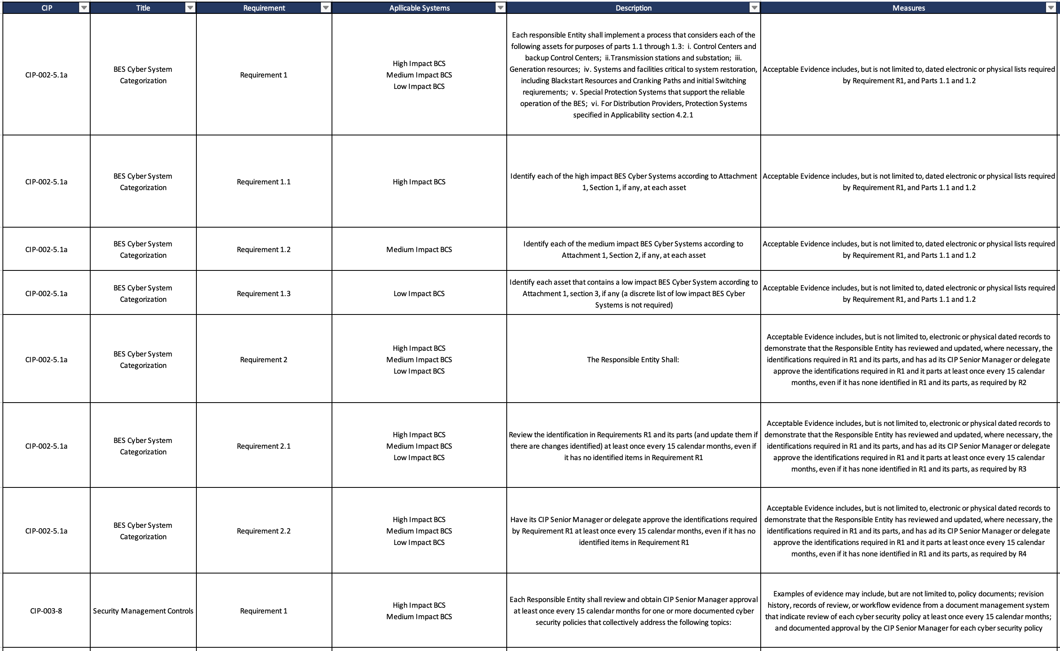
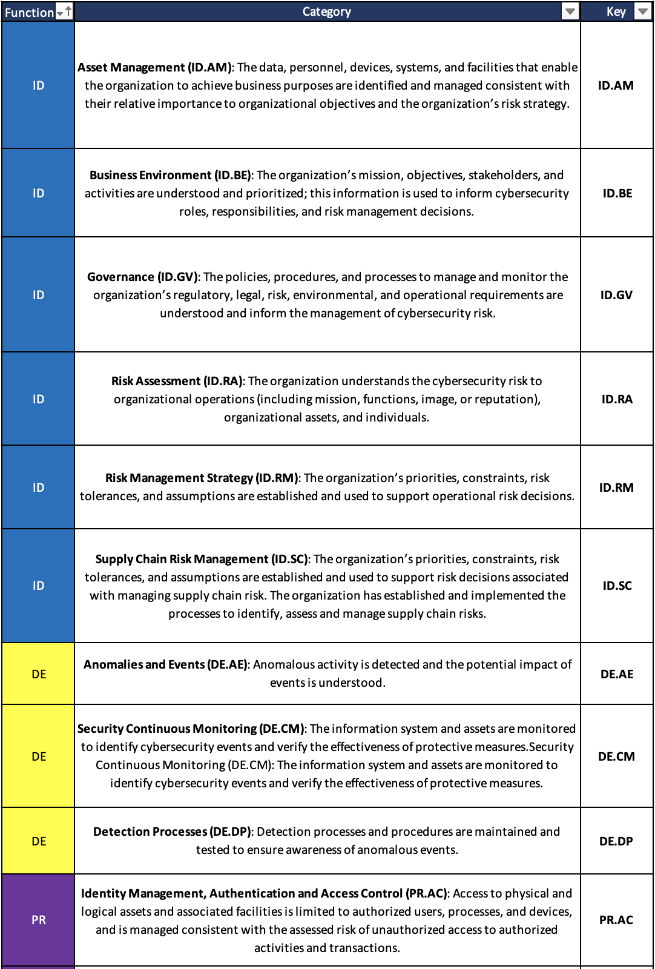
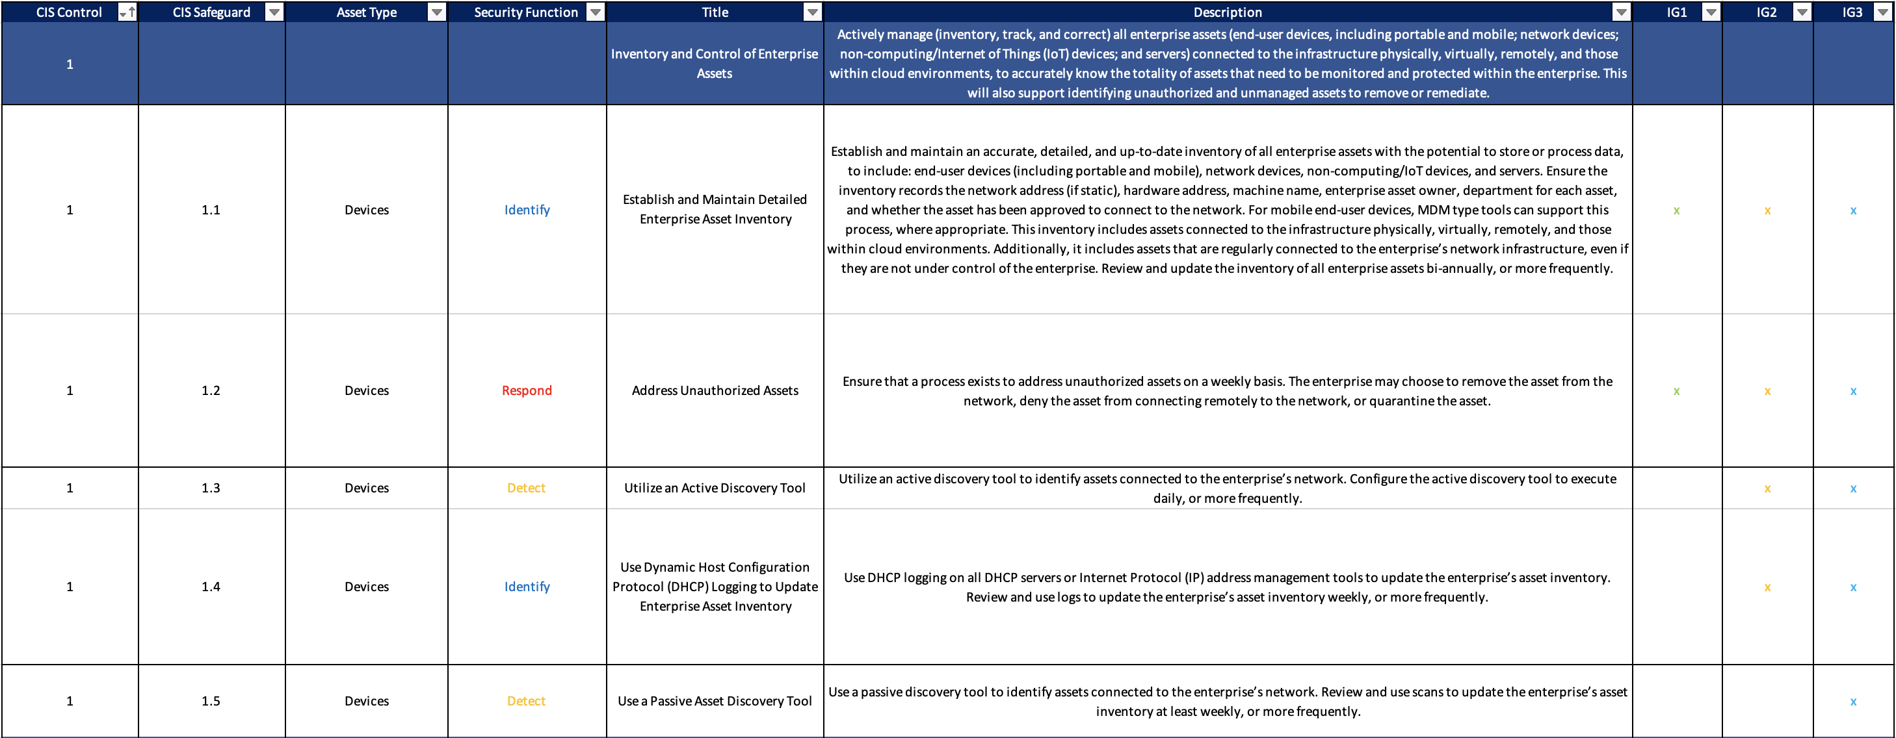

Slide 6
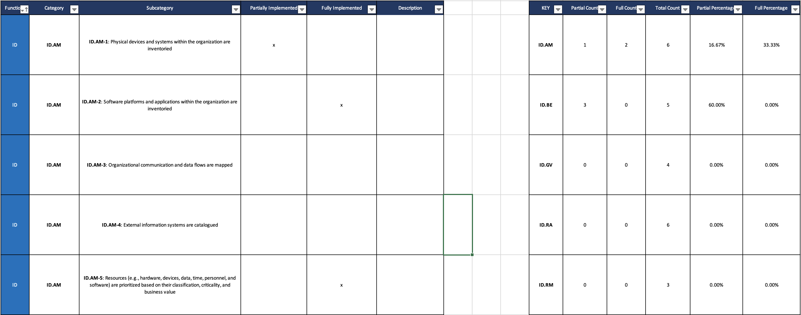
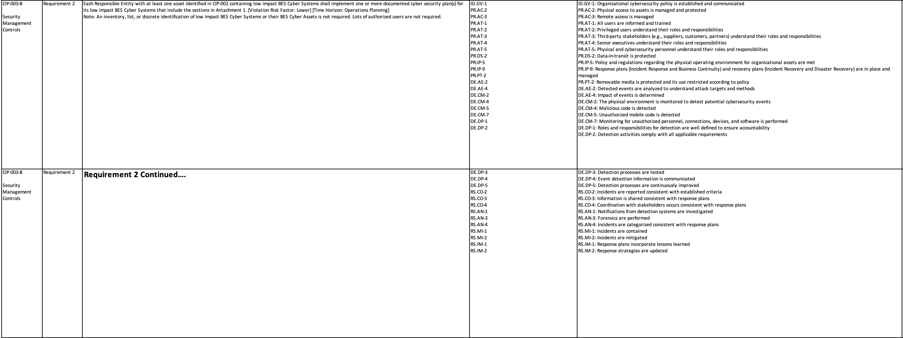

Slide 7
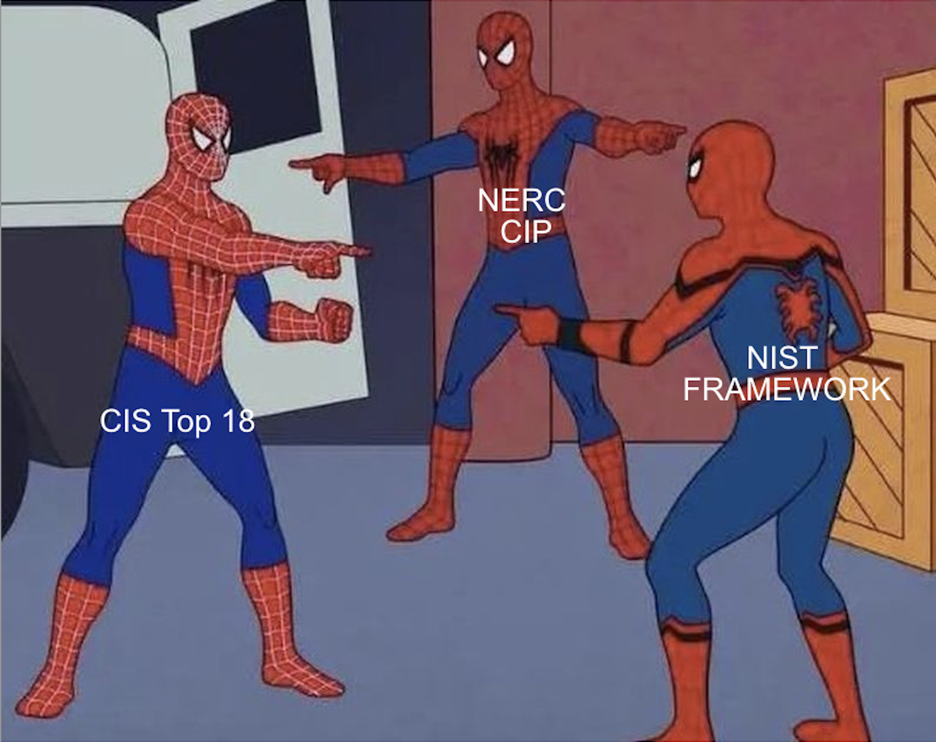
Hypothesis
My research project was designed to evaluate the hypothesis:
Cybersecurity standards across the nation possess only modest divergence in requirements and cybersecurity practices.

Slide 8
Conclusion
Hypothesis: Cybersecurity standards across the nation possess only modest divergence in requirements and cybersecurity practices.
171 Requirements Mapped
15 Did Not Map
8.77% “No Match”
91.23% Match
An overwhelming majority of the standards’ requirements mapped to each other. Mapping was based on language of the requirement or the intent of the requirement.

Slide 9
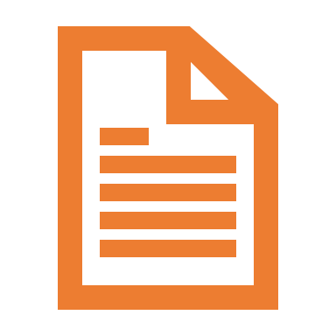

Project Context
Companies are forced to adopt Cybersecurity Standards:
Shareholders
Clients
US and/or Foreign Governments
Standard adoption isn’t easy:
Several Months to Years
Cost 10s of thousands to millions of dollars
If not adopted properly, standard violations can cost up to $1 million/day (worst case scenario seen so far)
Companies often adopt multiple standards. This project hopes to ease the adoption of secondary/tertiary standards.

Slide 10

Future Work
Future work that can be done on my project:
Implementing New Features
Integrating and Cross-Mapping More Standards
Scripting Data Importation Tools
Updating Upon Standard Re-releases

Slide 11
Challenges Along The Way
Standards
Cross Mapping Tool
Learning The Standards
Confusing Language
100s if not 1000s of Pages
Importing Information
Remove/Reformat Planned Features
Reformat Tables
Excel Formulas (30+ iterations)
Almost 1000 cells populated

Slide 12
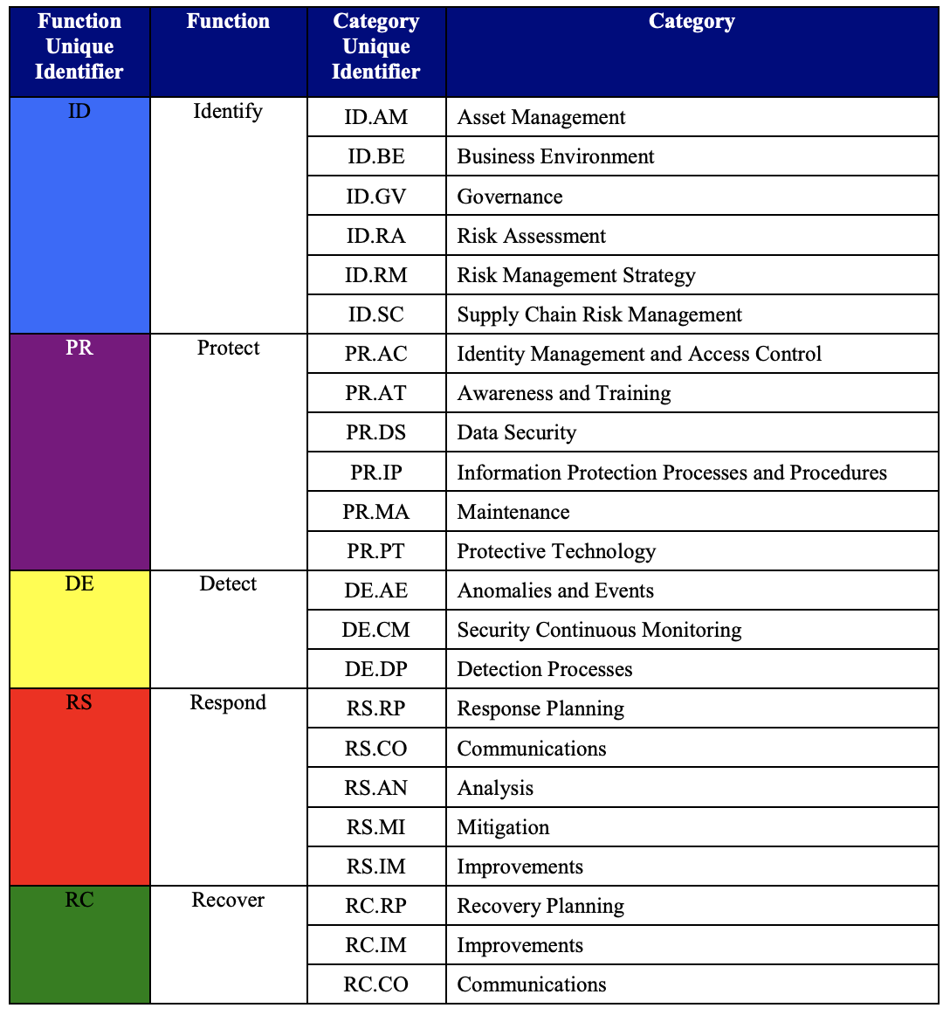
Lessons Learned
NERC CIP Standards
CIS Top 18 Standards
NIST Framework
Data Analysis Techniques
Time Management
Professional Development Techniques/Management
Many More!
NIST Framework Categories not showing the 108 sub-categories

Slide 13

Plans After Graduation
Network and Security Technologies
I was hired as a Cyber Security Consultant at NST where I will begin fulltime employment on June 6th.
https://www.nst.us/

Slide 14
Sources
https://www.cisecurity.org/controls
https://www.nist.gov/cyberframework/framework
https://www.nerc.com/pa/Stand/Pages/CIPStandards.aspx

